Slide 1
Introduction to STRaM Analysis Workflow in Galaxy (STRaM Loci Ver. 18)
Li Binglin
2025.05

Slide 2
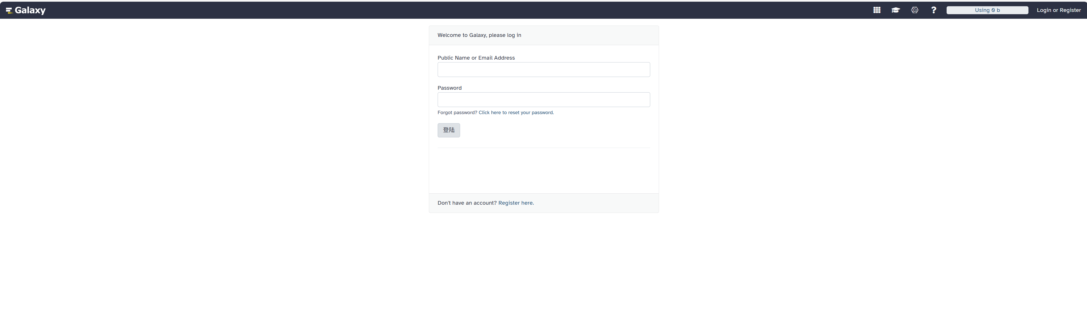
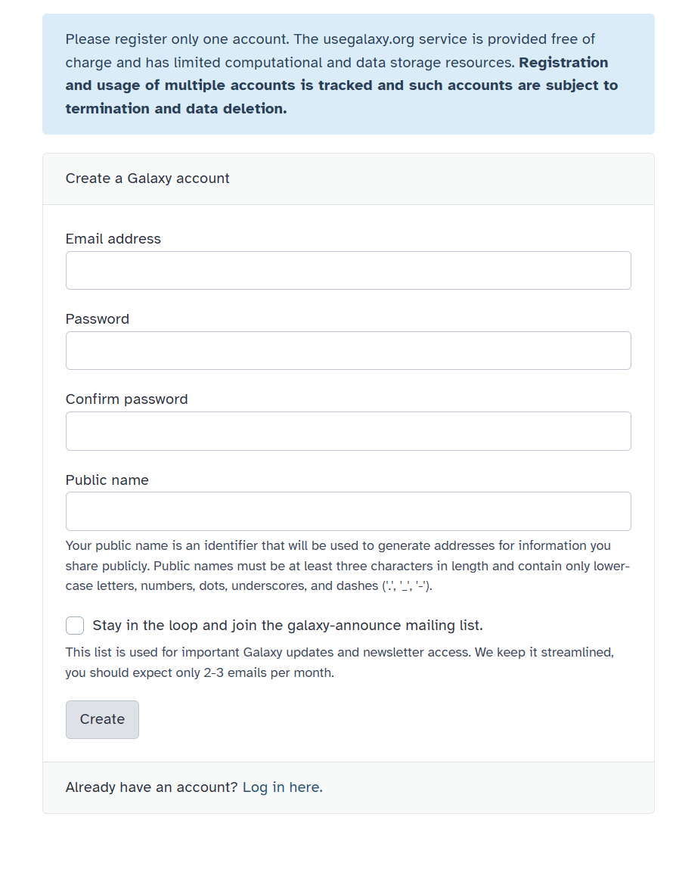
1. Apply for a web or lab Galaxy platform account
Login
Click to register
Galaxy of Web Platform (https://usegalaxy.org/)

Slide 3
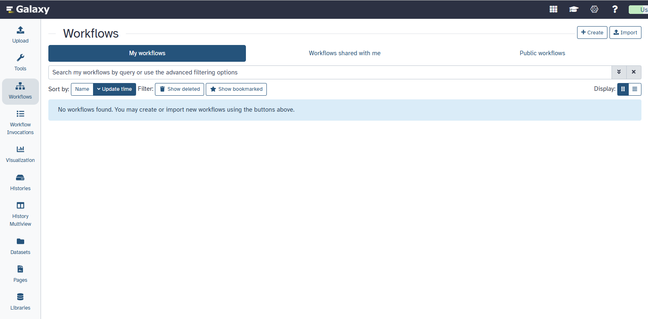
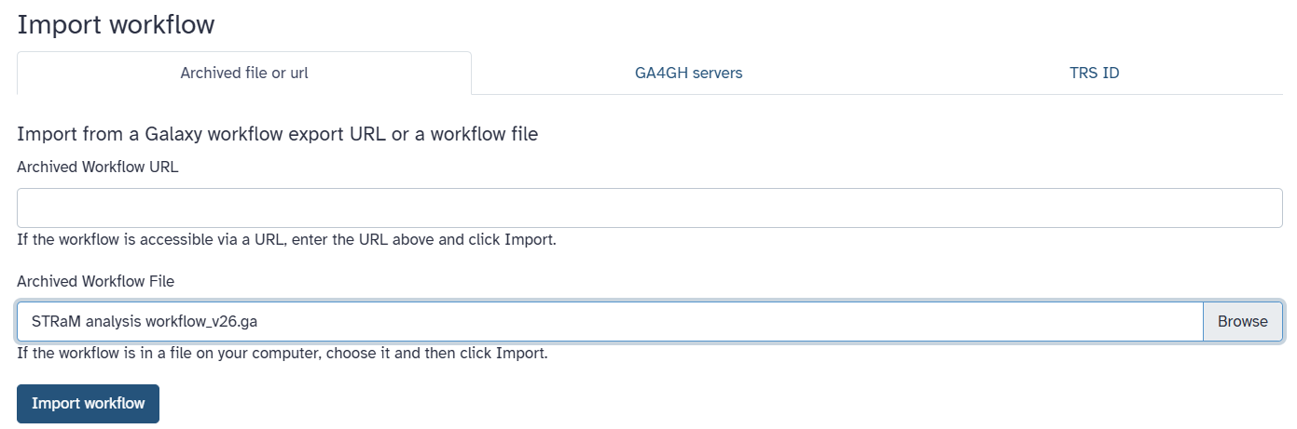
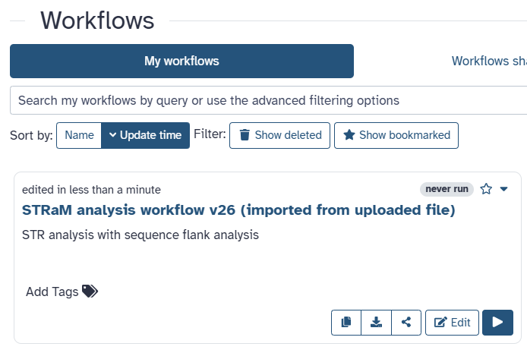
2. Import STRaM analysis workflow
2.1 Click the "Workflow" button.
2.2 Click the "Import" button.
2.3 Browse and select the latest STRaM workflow file and then click "Import workflow".
2.4 Workflow file will be uploaded successfully and displayed.

Slide 4
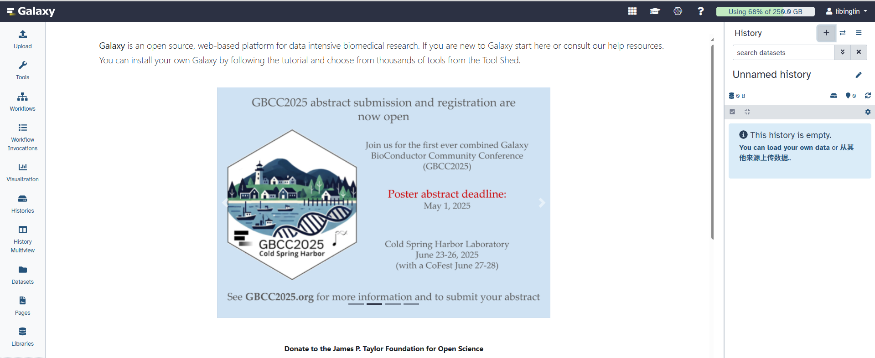
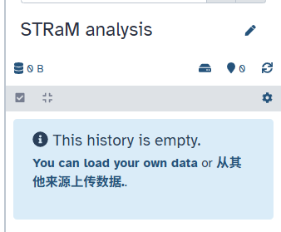
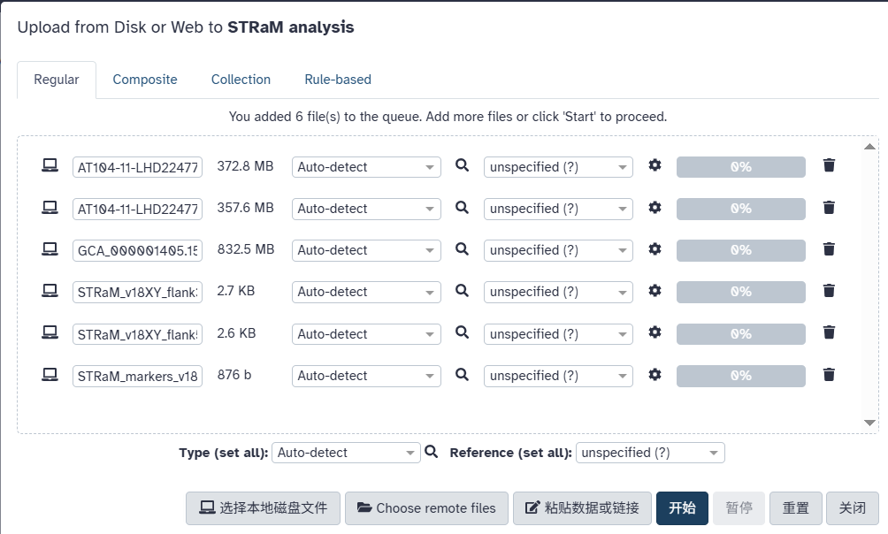
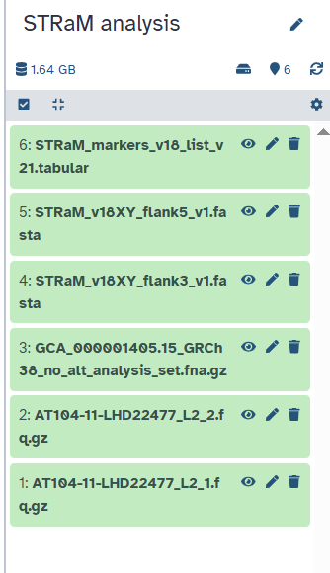
3. Upload all datasets into a new history in Galaxy Server
3.1 Create a new analysis history and assign a name, such as "STRaM analysis"
3.2 Click "Upload" button in the left menu bar..
Uploaded files
Raw data: Paired-end read 1
Raw data: Paired-end read 2
Reference human genome hg38
3’ reference flanking sequences of loci
5’ reference flanking sequences of loci
Marker name and genomic locations
3.3 Select "Local files", upload datasets from your local drives file.
3.4 Click "Start" to begin the upload.
3.5 Files will upload successfully and appear in your "STRaM analysis" history.
Note: The Raw data file shoule be uploaded before the reference genome file.

Slide 5
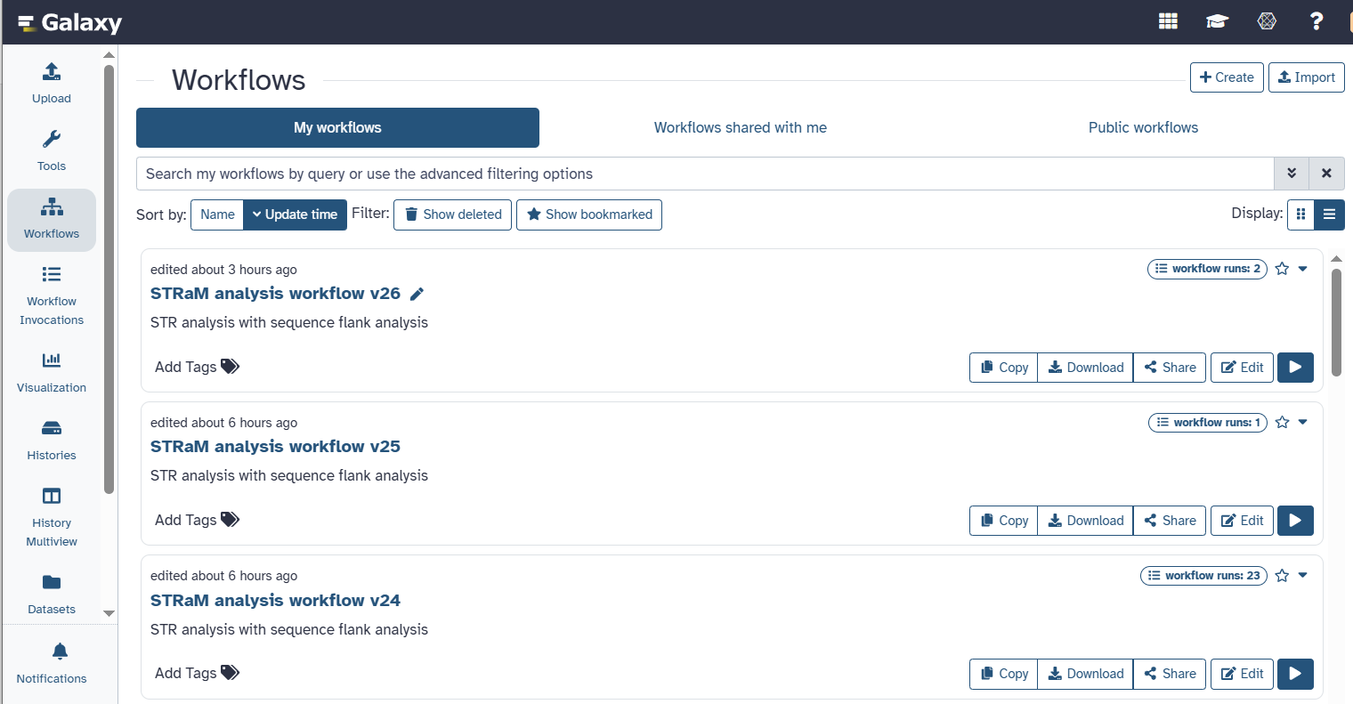
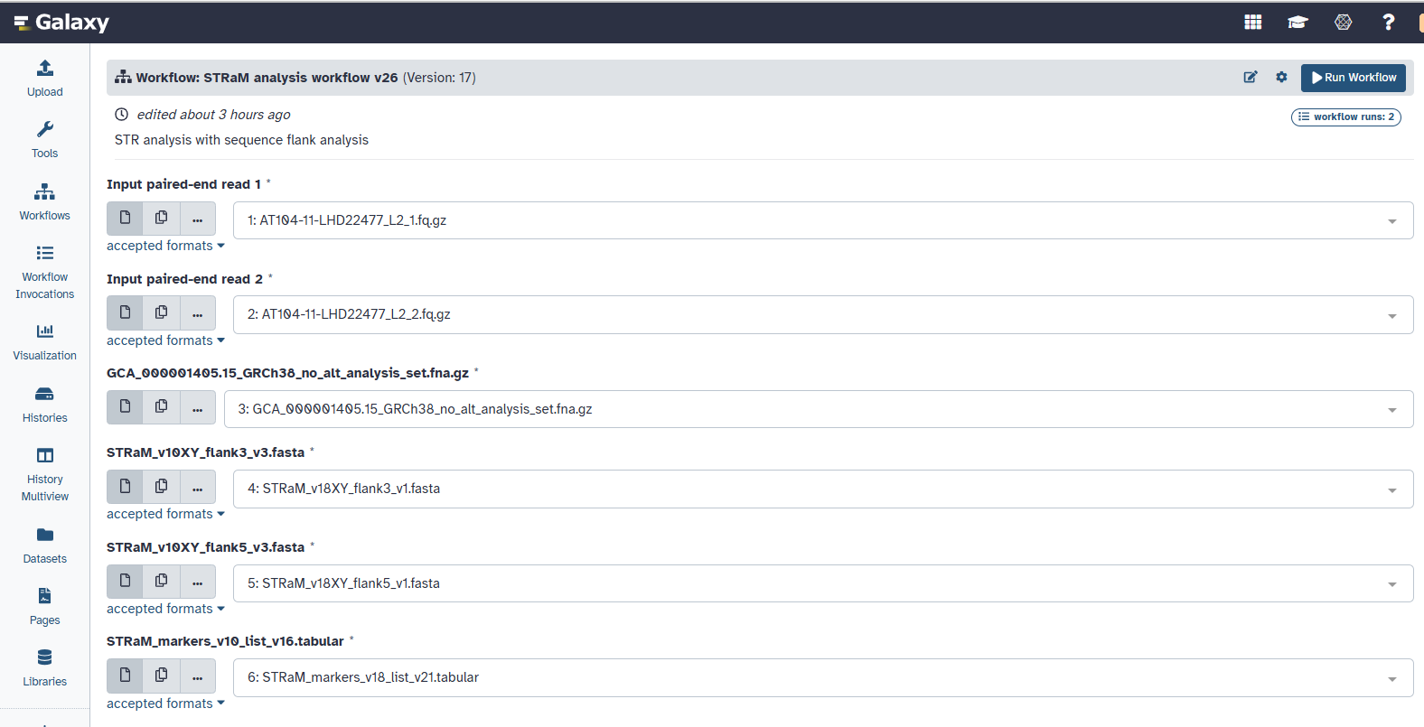
4. Run STRaM analysis workflow
4.1 Click “workflow” and run the uploaded STRaM workflow file.
Updated page
4.2 Select the uploaded datasets one by one, and then click “Run Workflow” to analyze the sequencing data.
Raw data: Paired-end read 1
Raw data: Paired-end read 2
Reference human genome hg38 (GRCh38_no_alt_analysis_set)
3’ reference flanking sequences of loci (STRaM_v18XY_flank3_v1.fasta)
5’ reference flanking sequences of loci (STRaM_v18XY_flank5_v1.fasta)
Marker name and genomic locations (STRaM_markers_v18_list_v21.tabular)

Slide 6
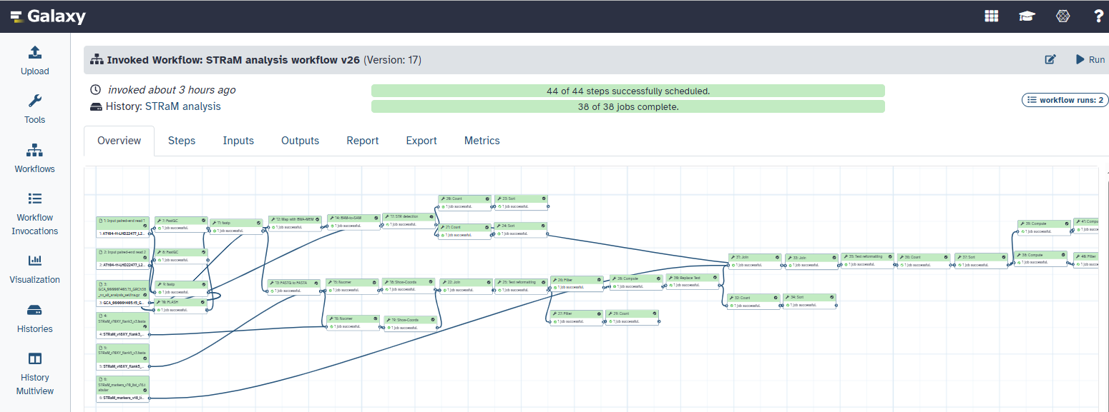
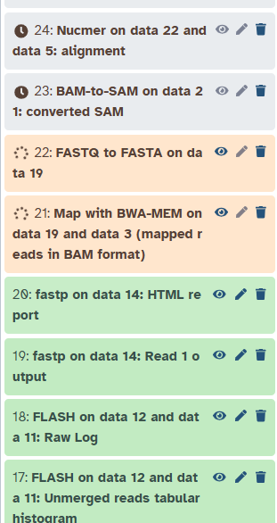
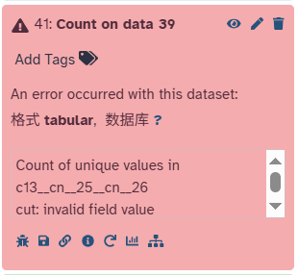
5. Running
5.1 Running
5.3 Running Completed
Grey: Pending;
Orange: Running;
Green: Success;
Red: Error.
5.2 Troubleshooting
Note: Since the web platform is updated regularly, some tools may encounter errors. Troubleshooting is required for these tools according to error reports.

Slide 7
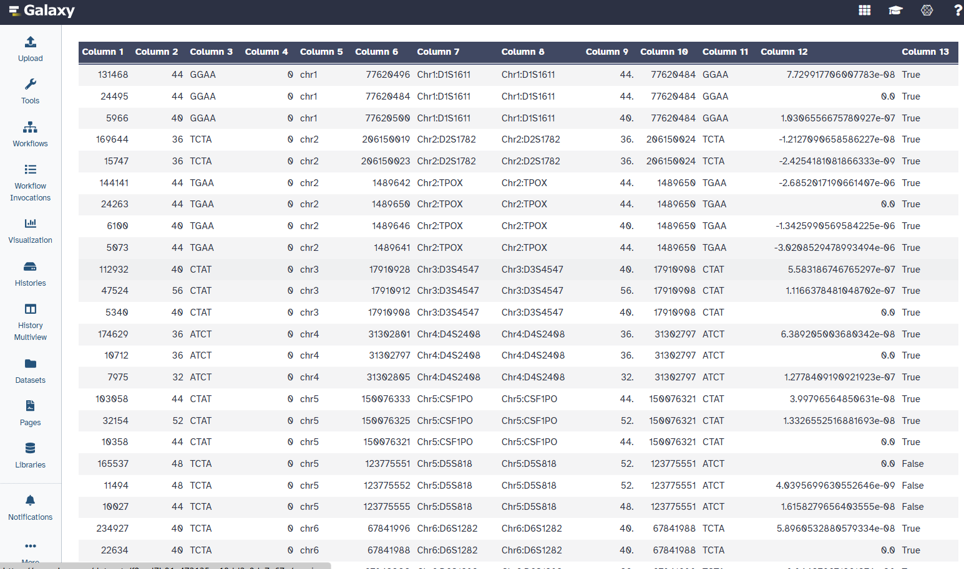
6. Result output
Column 1 = reads count
Column 2 = length of STR (bp)
Column 3= repeat motif (bp)
Column 4 = hamming distance
Column 5 = chromosome
Column 6 = left flanking region stop
Column 7 = Marker name
Column 8 = Marker name
Column 9 = STR length of STR flank analysis
Column 10 = the start coordinates of the STR sequence in the genome
Column 11 = repeat motif
Column 11 = The difference in the STR start positions
Column 11 = STR length comparison of the STR length
6.1 Download the output tabular.
6.2 Perform subsequent analysis to distinguish between allele and stutter signals.
6.3 STRaM profiles collection and sample assessment

